Slide 1
Student Dropout Prediction

Slide 2
TEAM PRESENTATION
Midhilesh Dusanapudi
700732415
Yamini Garikapati
700732498
Preethi Bukka
700741930
Sai Sree Chikkala
700726877

Slide 3
Roles and Responsibilities
Midhilesh Dusanapudi | Setting goals and work allocation | Data cleaning | Feature selection stage-I | -
Yamini Garikapati | Removing constants | Removing quasi constants | Feature selection stage-II
Preethi Bukka | Selecting the best features | Correlation matrix | Select K Best | Sequential Feature selection
Sai Sree Chikkala | Creating reports | Machine learning models | Comparative analysis
All |  | Uploading the code into github | Video recording of the project | Final report

Slide 4
Objectives
1
The objective of our project is to classify the dropout students from the given data
2
Applying various feature selection methods to select the important features from the dataset.
3
Training the machine learning binary classification models to predict the dropout student

Slide 5
Problem Statement
There are different factors that trigger student dropout rate in Universities or in schools. Now educational institutions are in search of finding the answers what factors trigger the most. As per the studies there are plethora of factors that can cause this situation. But manually analyzing the causes is a cumbersome task. A simple prediction tool for classification of dropout or consistent student helps the organization improve the dropout rates.

Slide 6
Proposed solution
Machine learning offers simple and user-friendly techniques to predict using complex dataset. Student dropout prediction is a natural problem in educational institutions and is current challenge to overcome. This dropout rate causes vary depending on the type of institution online or offline, student economical background, student participation in the curricular activities, instructor’s role etc.
In this paper we are implementing various feature selection methods to select important features and classification algorithms.

Slide 7
Motivation
Educational institutions also adapting the new technologies in decision making process. This is one of the industry where decision making is driven by data. It produces the data where it should be analysed before making the decisions. Machine learning algorithms with powerful data analysis and interpretation techniques makes the process easy.

Slide 8
Related work
There are 3 types of feature selection methods: filter, wrapper and hybrid.
One of the feature selection methods is filter method.Filter method selects the features using correlation with dependent variables.A correlation matrix is constructed internally and selects a subset of most correlated features [1]. In this paper we are proposing all the methods and conduct a comparative analysis [3].Student prediction dataset contains multiple columns which correlated with the dependent values.These can be boiled down to reduced set using these methods.Hybrid feature selection method ensures the best of both the algorithms i.e. filter and wrapper.Again this methods are subdivided into feature selection for categorical values and numerical values.For categorical values chi-squared test is implemented.Chi-square test is statistical procedure to measure how good the fit is.This is one of the best method to calculate the subset of corpus.Mutual Information calculates how independent feature depends on independent feature if there is no relation then the Mutual Information value is set to zero.For numerical values Mutual Information and Pearson correlation is used[2].
Training time of the model depends on various parameters. One of the most important factors is complexity of the data and dimension of the input features.Reducing the dimensions of the input features improves the training performance[4].

Slide 9
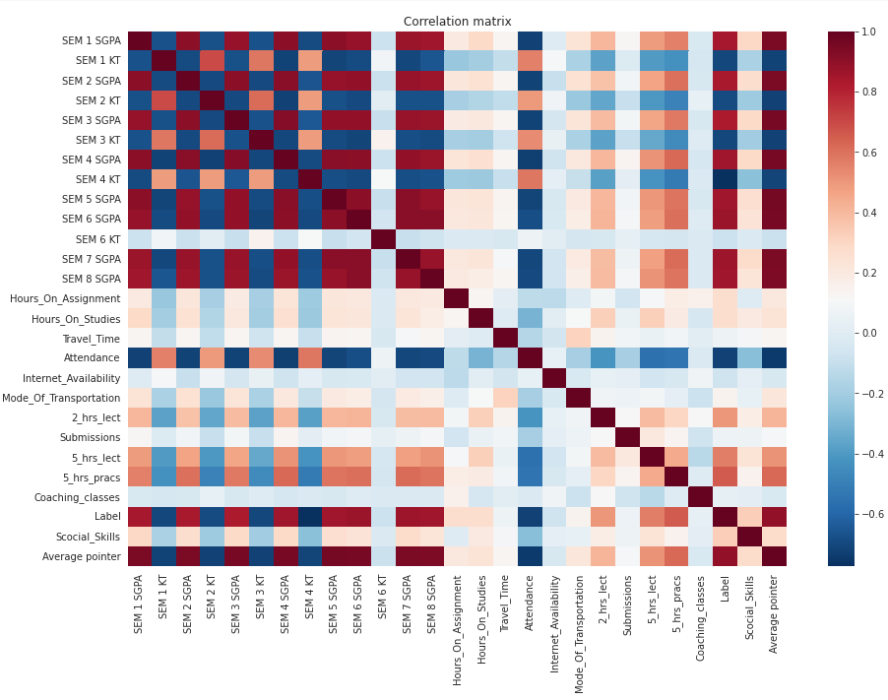
Results
As a part of feature selection implementation Correlation matrix is constructed.
Columns are filtered using a condition more than 80% correlation and 25 features are boiled down to 18 columns

Slide 10
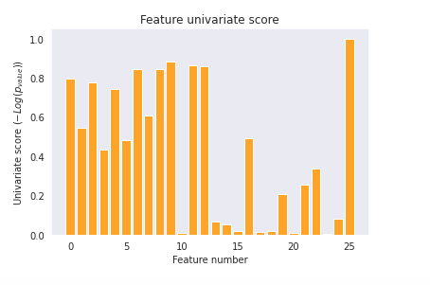
Results
Correlation matrix doesn't capture non linear relationships
So univariate feature selection method is implemented to avoid the disadvantages of correlation matrix
To implement Univariate feature selection SelectKBest is implemented using Sklearn

Slide 11
Results
After applying feature selection methods correlation matrix, Univariate feature selection(Select K Best), Sequential feature selection(forward and backward)
Naive Bayes and KNN algorithms are applied for classification
Naive Bayes classifier performed well on the correlation features and achieved 98% accuracy without any bias.
For this classifier classification report and confusion matrix is constructed to explore the other performance metrics

Slide 12
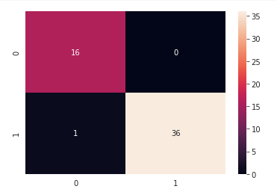
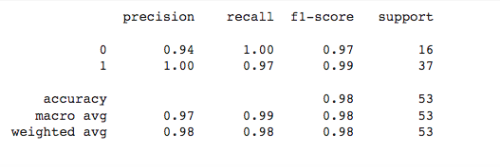
Results

Slide 13
References
[1].D. M. Belete and D. H. Manjaiah, "A Comparative Study of Filter and Wrapper Methods on EDHS – HIV/AIDS Dataset," 2020 Third International Conference on Smart Systems and Inventive Technology (ICSSIT), 2020, pp. 1264-1271, doi: 10.1109/ICSSIT48917.2020.9214212.
[2].P. H. Prastyo, I. Ardiyanto and R. Hidayat, "A Review of Feature Selection Techniques in Sentiment Analysis Using Filter, Wrapper, or Hybrid Methods," 2020 6th International Conference on Science and Technology (ICST), 2020, pp. 1-6, doi: 10.1109/ICST50505.2020.9732885.
[3].T. Georgieva-Trifonova. “Research on Filtering Feature Selection Methods for E-Mail Spam Detection by Applying K-NN Classifier.” International Congress on Human-Computer Interaction, Optimization and Robotic Applications (HORA), 2022, pp. 1-4. 10.1109/HORA55278.2022.9799999.
[4].H. Nhaila, A. Elmaizi, E. Sarhrouni and A. Hammouch, "New wrapper method based on normalized mutual information for dimension reduction and classification of hyperspectral images," 2018 4th International Conference on Optimization and Applications (ICOA), 2018, pp. 1-7, doi: 10.1109/ICOA.2018.8370546.

Slide 14
Thanks!

